Slide 1
Bending light
Light can bend when it enters or leaves a glass block.
a. Which glass block do you think bends the light the most?
A
B
C
Notes:
https://pixabay.com/vectors/finger-forefinger-trigger-finger-310854/

Slide 2
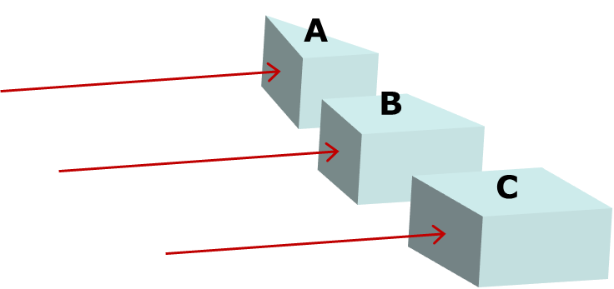
Bending light
b. What is the best reason for your choice of glass block?
A
Light goes through the most glass
B
Light goes through the least glass
C
It is the most unusual shape
D
Light hits at the biggest angle
E
Light hits at the smallest angle

